Slide 1
bit.ly/cil22-static-sites
COMPUTERS IN LIBRARIES 2022
Freeing Yourself From the Database
Developing with a Static Site Generator
Notes:
As a web services librarian, I want to focus on providing our university with the best resources and services, not worrying whether our site is going to get hacked.
Freeing ourselves from a traditional content management system and going with a static site generator wasn't the easiest task, but we're quite content with the decision.

Slide 2
Hello!
Jerry Yarnetsky
web services librarian
Miami University of Ohio
Notes:
Hello from beautiful Miami University of Ohio!
I'm Jerry Yarnetsky and It's wonderful to be here with you.
I'm on the team which manages our libraries website. I also take the lead for frontline web services such as LibGuides, and user experience issues such as web accessibility and testing.
I also teach an undergrad course here in interaction design and development.

Slide 3
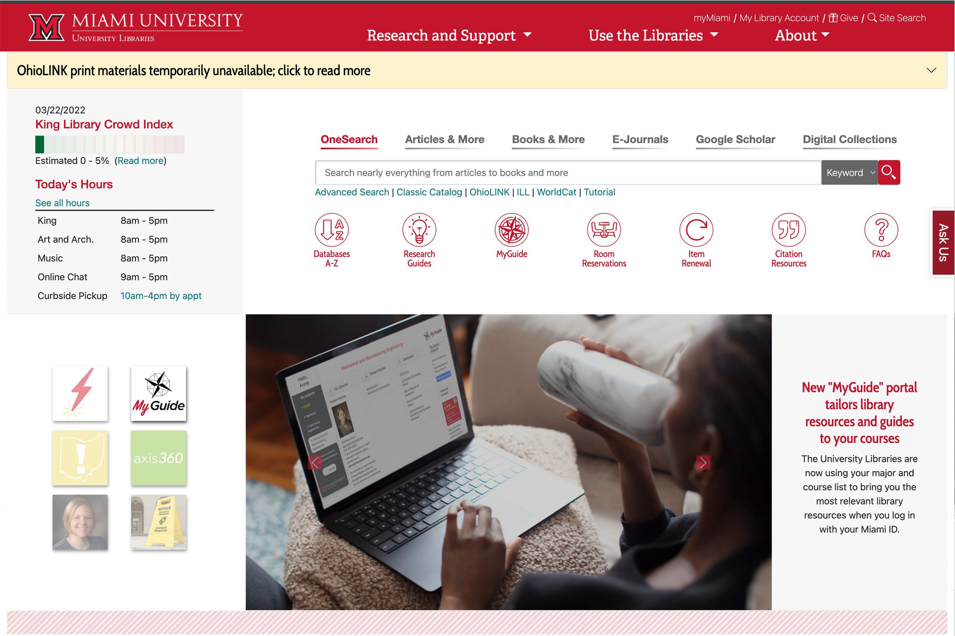
Notes:
This is our libraries website built using the popular static site generator Jekyll
In the next 14 minutes I'll explain the static site generator approach to web development, outline the pros and cons of this approach, and look at use cases.
In the process, I'll share how we've approached their use.

Slide 4
?
UuMUfQ, CC BY-SA 3.0
via Wikimedia Commons
Notes:
How did we get here?
In 2018, our Drupal 7 site couldn't host the new features we wanted to implement was facing a scheduled end-of-life.
We considered simply upgrading to Drupal 8, but decided that we also had an opportunity to start from scratch. So we explored the webdev world to see if there was a better way to suit our needs.

Slide 5
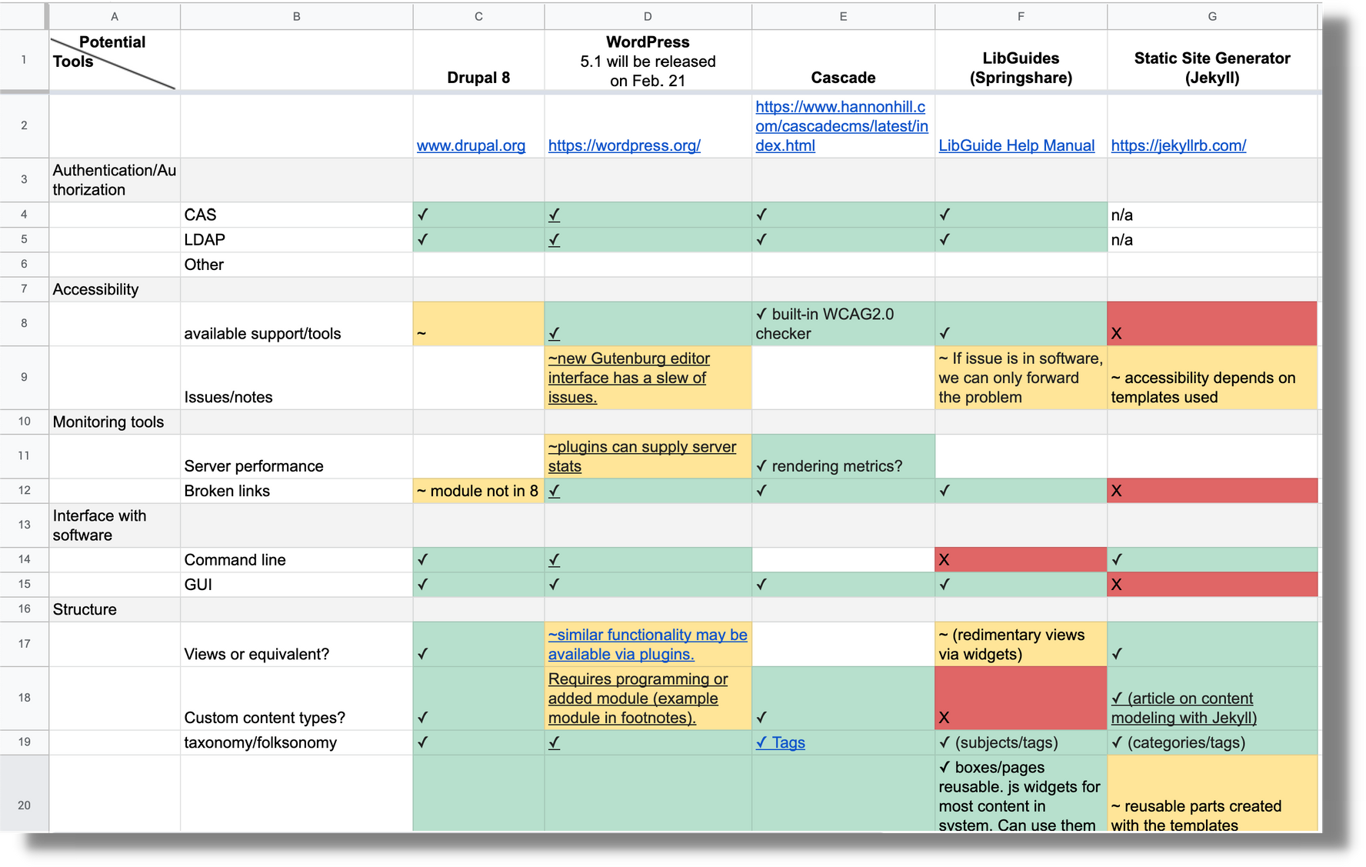
a found spreadsheet from our early exploration phase
Notes:
We wanted to create a site that had rock solid performance and low security exposure. We also needed to ensure full accessibility compliance.

Slide 6
GitHub
"In collaboration we trust #github #octocat" by sfadden CC BY-NC 2.0
Notes:
But what became a deciding factor was the ability to build a collaborative development environment with the version control and peer-review.
GitHub provided this environment, but our attempts at integrating Drupal into this workflow proved painful.
That led us to reconsider our entire approach and look at the Git-centric model of the JAMstack that use static site generators.

Slide 7
Let's start with how
a typical CMS works...
Canva clipart
Notes:
Before we jump into this new approach, let's do a quick recap of the approach used by sites using traditional content management systems such as Wordpress and Drupal.

Slide 8
client
server
Request
Notes:
These follow a request-response model...
When we enter a site in our browser, we're making a *request* from the server for specific content— such as our libraries homepage.

Slide 9
client
server
Request
web server
CMS app
Database
Notes:
The CMS, on demand, finds the requested content in its database and pushes it through display templates in real time to create the requested page.

Slide 10
client
server
Response
web server
CMS app
Database
Notes:
The web server's response is to take resulting HTML and send it back to the client's browser.

Slide 11
client
server
Request
web server
Response
CMS app
Points of attack and performance loss
Database
Notes:
If traffic suddenly spikes, such as when content goes viral, this real time cycle of fetching content can bring a server to its knees. Even robust servers have their limits.
This very cycle also provides openings for cyber attacks— Denial of Service Attacks use automated bot traffic to overwhelm servers. The database itself is also a major target such as from SQL injection threats.

Slide 12
web server
CMS app
So we cache
to compensate
Notes:
One way developers compensate is to create cached versions of their site— temporary static copies that are served instead of fresh copies from the database on every request.

Slide 13
What if...
the app and database were
not even on the server?
Canva clipart
Notes:
But… what if the whole development model started from this point?
What if the app and database were not even on the server?
What if this cached version was the *intent* instead of the workaround?

Slide 14
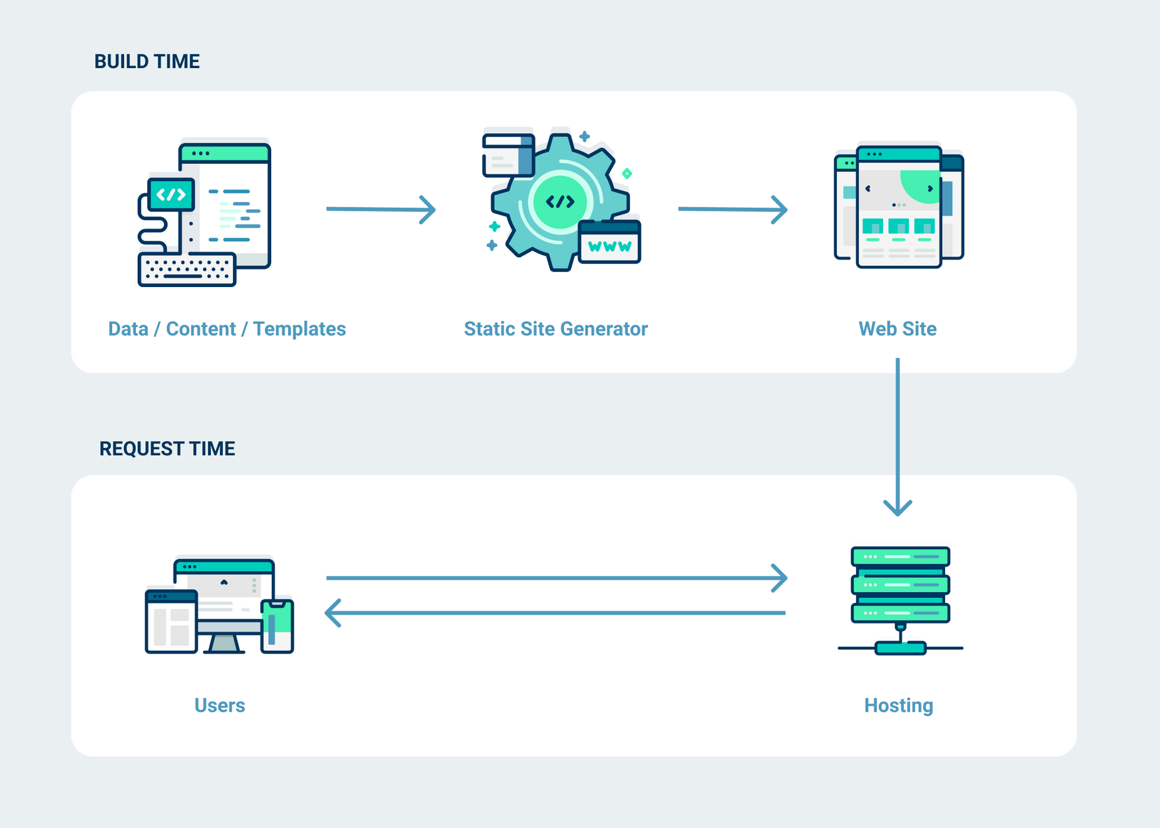
netlify.com: what is a static site generator
Notes:
This is the premise of the JAMstack and where static site generators come into play.
Before a browser ever visits our site, we pre-build everything.

Slide 15
Textual content
Markdown, CSV, HTML, & JSON
netlify.com: what-is-a-static-site-generator
Notes:
We start with content stored in simple text files, such as text in markdown format or CSV files stored in a Git repository, on your computer, or requested through APIs — data streams from other servers.

Slide 16
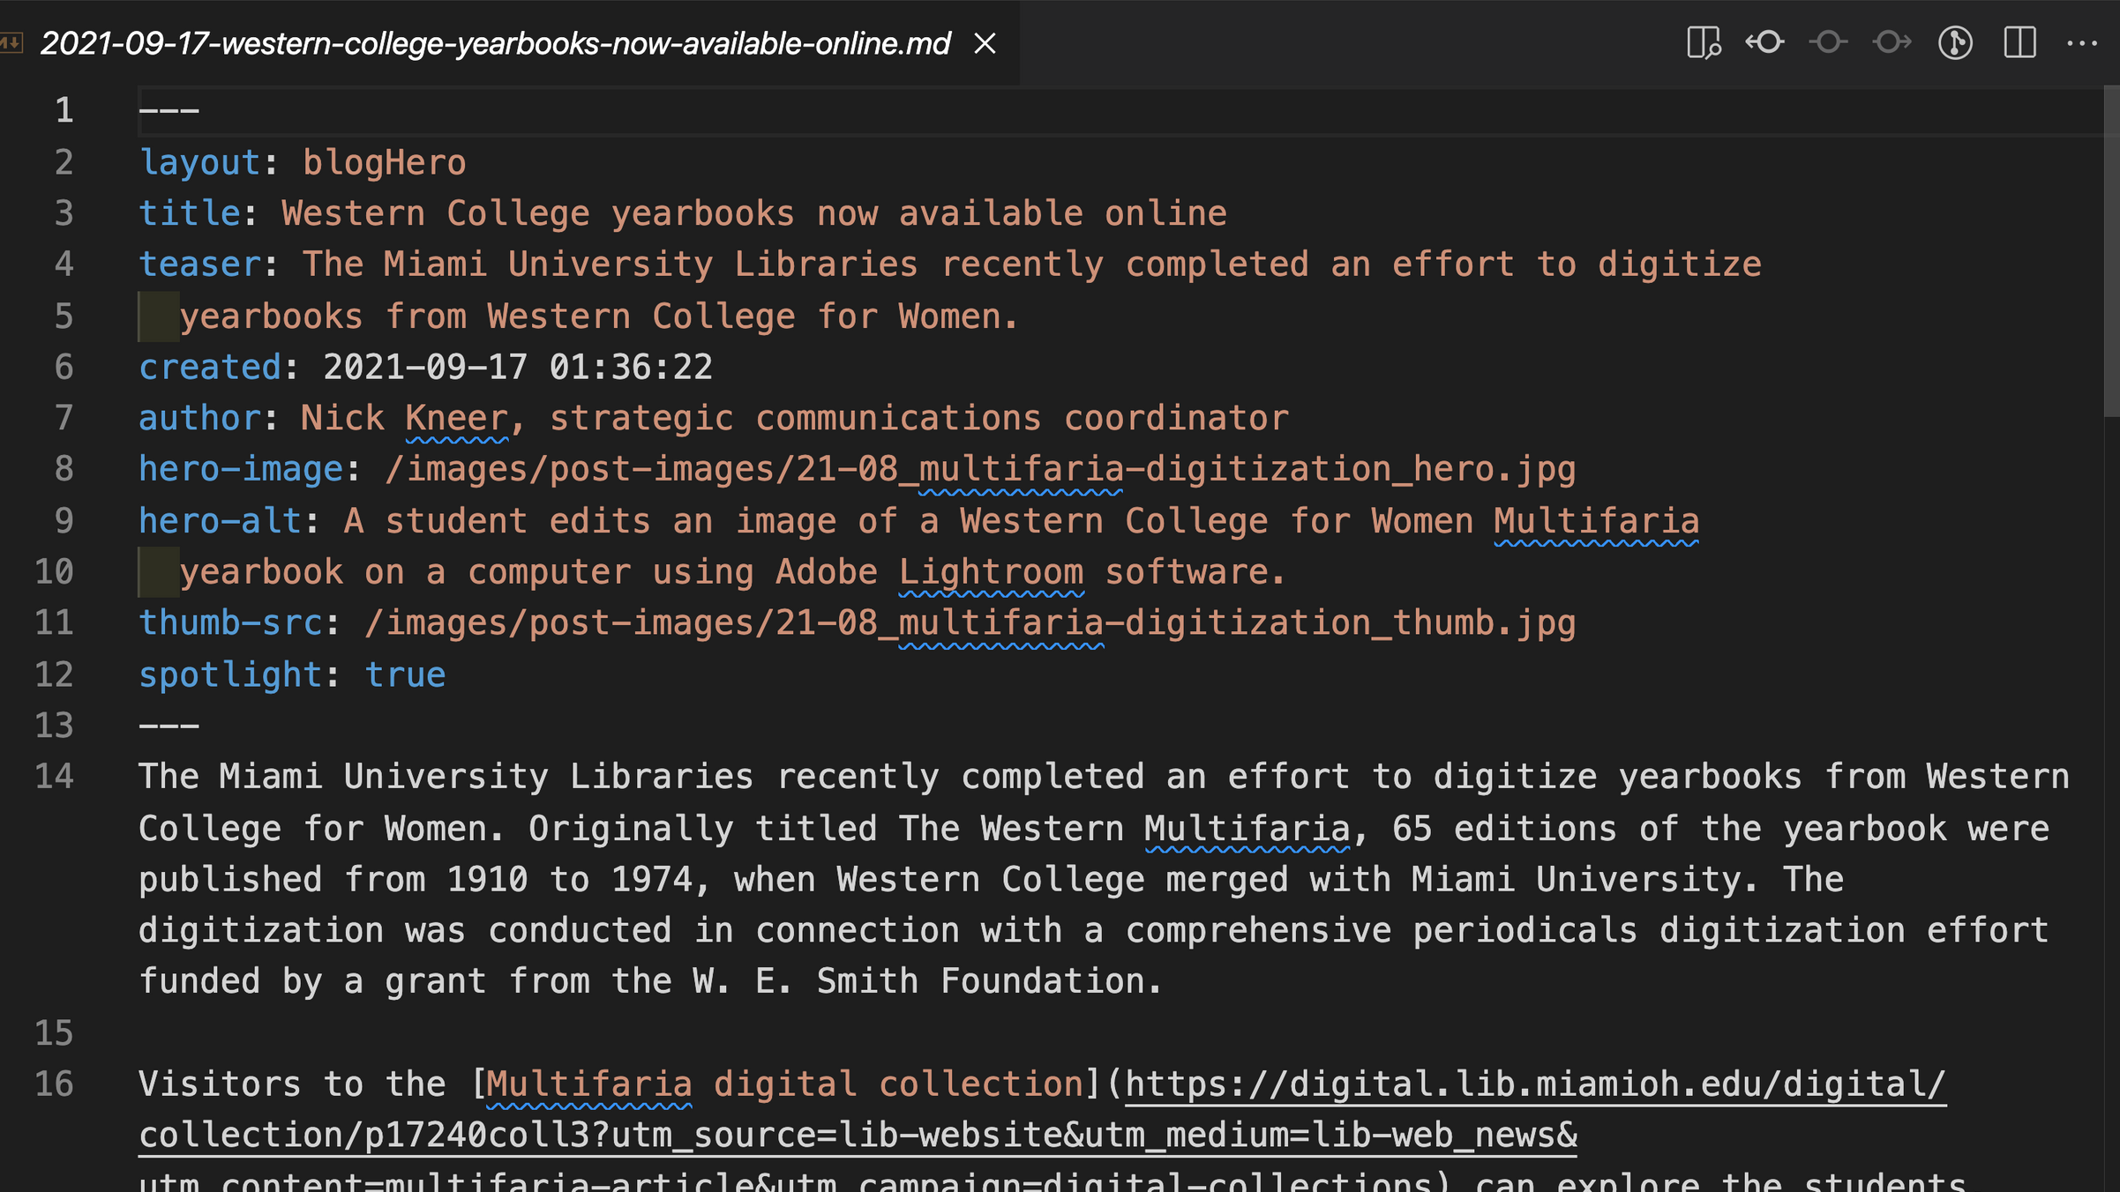
Content + metadata
netlify.com: what-is-a-static-site-generator
Notes:
Here's an example of a markdown file from one of our library website blog posts.
These files can include both content and a wide range of metadata about our content such as authors, categories, and content tags called front matter.

Slide 17
Content is run through templates
netlify.com: what-is-a-static-site-generator
Notes:
Then, in a build process with similarities to mail merge, our static site generator app pushes this content through a series of templates to create HTML files.

Slide 18
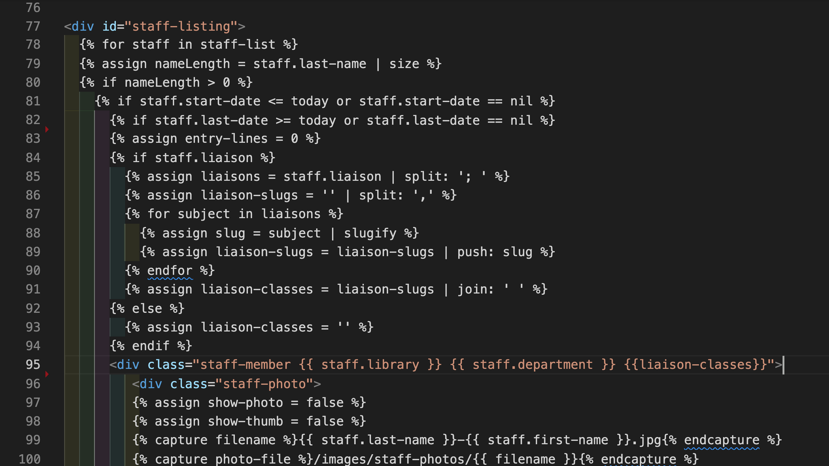
Loops and conditionals
provide ample flexibility
Notes:
The templates can include a wide range of conditional and looping statements based on the metadata stored in our content files.
This allows us to build sophisticated sites for a wide range of content.
For example, we have a CSV data file of employees. One of the conditionals in our template hides employees if they have not yet started or taken a new position.

Slide 19
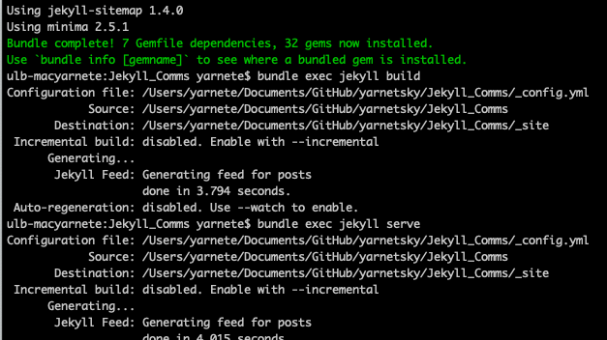
Many SSGs are command-line tools
Notes:
For many static site generators, builds can be triggered manually through a command-line instruction or automatically through an action scheduled on your server.
Here our build command is "bundle exec jekyll build"

Slide 20
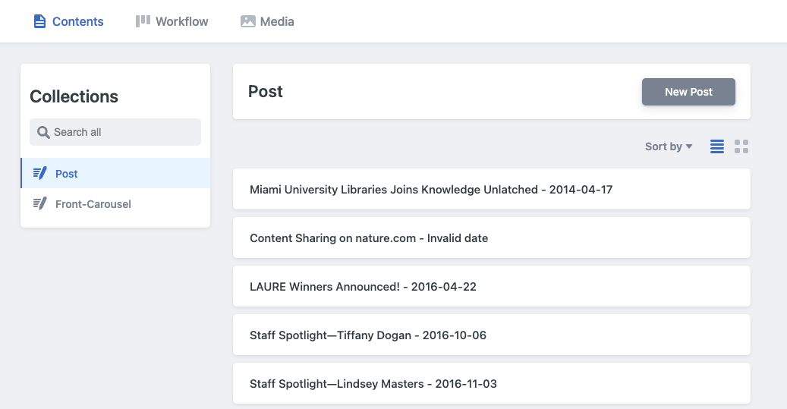
Notes:
But fear not, while many static site generators are geeky command-line tools, there are multiple graphical tools on the market!

Slide 21
Output is
static HTML
netlify.com: what-is-a-static-site-generator
Notes:
So, the generator's end result is simply a static HTML site written to a dedicated folder.

Slide 22
No database
or app needed
netlify.com: what-is-a-static-site-generator
Notes:
As a result, we no longer need a database nor any applications such as Wordpress — just a web server such as Apache or Nginx [engine X]

Slide 23
Now only
a static site
is delivered
netlify.com: what-is-a-static-site-generator
Notes:
Now upon request, the only thing the server needs to do is send back the static HTML, which they are super good and super fast at.
"Hold up," you ask. "If everything is static, how do you handle dynamic content?"
This is where APIs come into play.

Slide 24
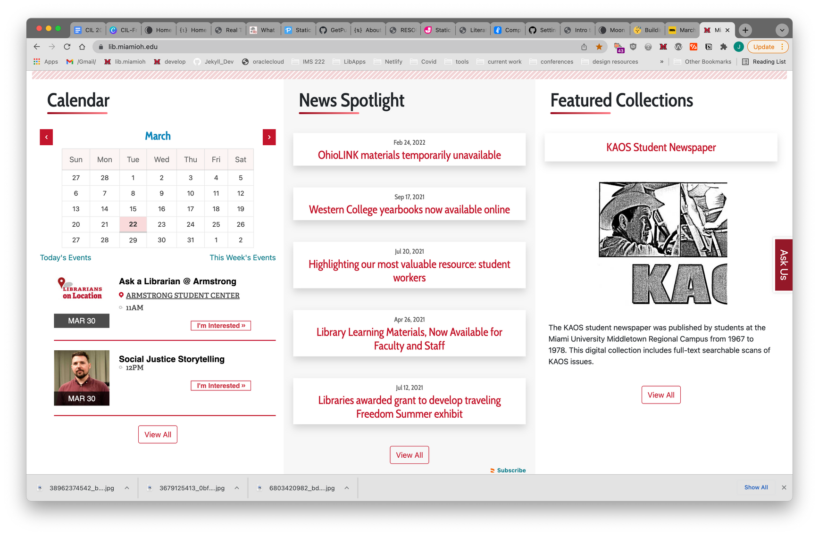
Content updated through our static site generator
Notes:
Here's how we handle changing content with our libraries website.
For changing static content, we can rebuild immediately as needed via command line instruction.
However, we usually let our automated hourly server builds snag our daily updates such as changes to library hours, featured content, or news blog posts.

Slide 25
Dynamic content or tools via APIs
Notes:
For dynamic content and live tools, such as Ask-a-Librarian chat, we use APIs.
APIs are essentially messengers bringing in application specific data from outside servers. Javascript then parses this data live on your browser instead of on our server.
On our site, we also use APIs for our emergency message, our library events calendar, social media data, and our innovative use of wifi to estimate our library capacity. (It was spring break when I did this video)
Additional uses of APIs for static sites could include blog comments, authentication, news, and e-commerce.

Slide 26
J
A
M
JavaScript
APIs
Markup
JAMstack
Notes:
They've given this approach to web development the peanut butter and jelly sounding name of JAMstack — an acronym for Javascript, APIs, and Markup.
Let's take a look at the cons and pros of this approach. I'll look at the cons first.

Slide 27
Content repository
Content management
static site generator
site hosting
Notes:
Probably the biggest con for beginning users is that the JAMstack model is frequently not a one-stop shopping experience, but rather a collection of tools working together.
We're used to the Wordpress model where we buy hosting and the host has Wordpress pre-installed and everything is ready to go.
The JAMstack model can have up to four autonomous parts
-a content management tool
-the content repository
-the static site generator
-and site hosting.
Each of these pieces can be in different locations depending on the tools you're using.

Slide 28
Yeah, command line...
Notes:
A related downside is that many of the tools lack a graphical interface.
As a result, their installation, configuration, and use require working with text configuration files and the command line.

Slide 29
Notes:
On top of all this, the market feels like the wild west.
This dev model really only reached critical mass in 2020. Now millions are being invested and this market is developing rapidly.
These are just a few of the popular jamstack tools. They're written in every major programming language and framework from Javascript and Ruby to Python and Rust.
Let's flip to the pros.
Thankfully, this very same crazy emerging market is also creating ways around the downsides!
Here are a few quick examples...

Slide 30
NetlifyCMS
Notes:
The headlining feature are graphic interfaces to work with static site generators.
Our libraries' communications team uses the open source NetlifyCMS to manage blog posts and featured content on our website.

Slide 31
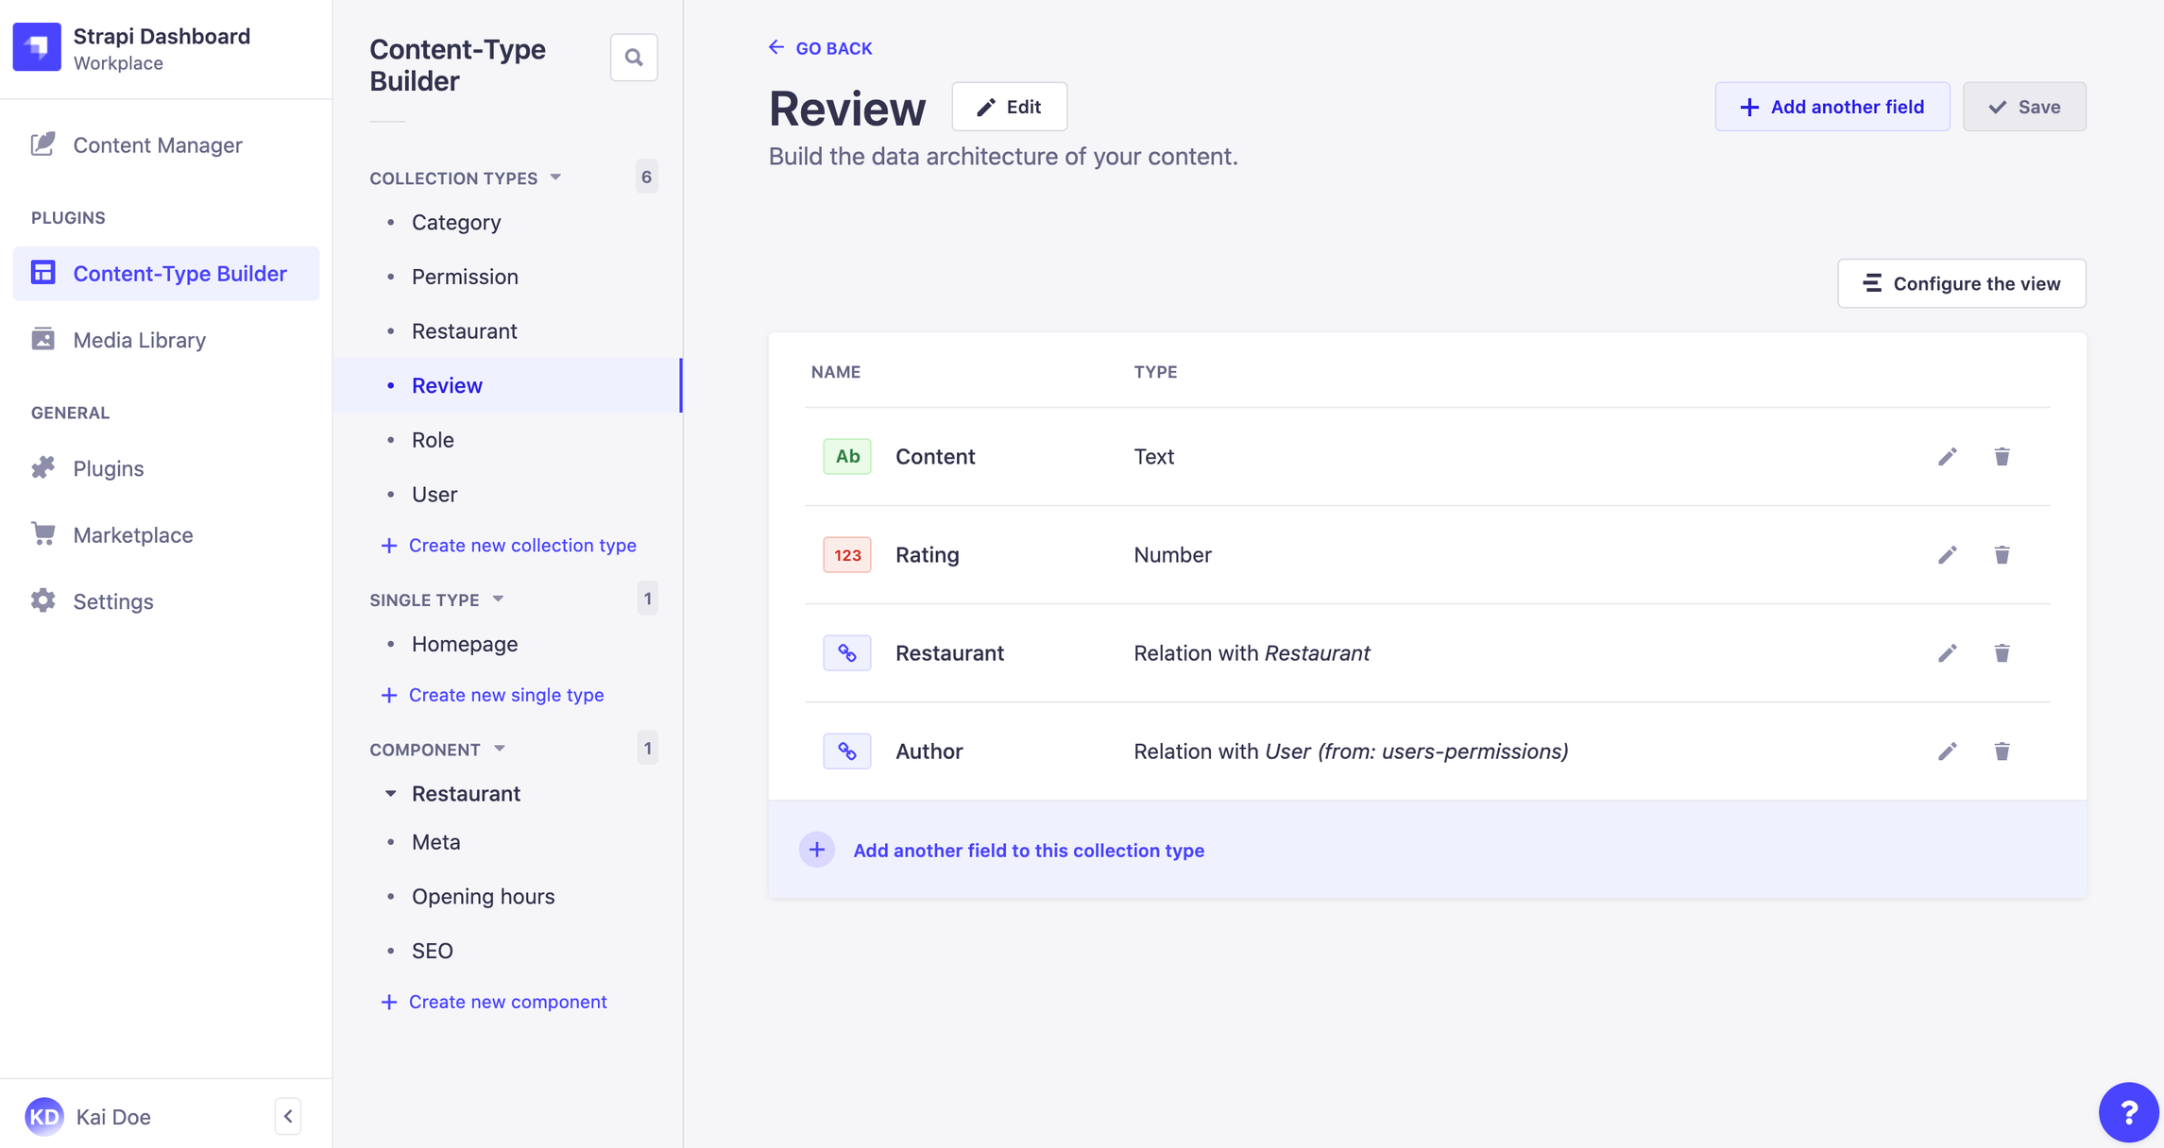
From Strapi documentation: https://docs.strapi.io/user-docs/latest/content-types-builder/introduction-to-content-types-builder.html
Notes:
Strapi has become a top open source project due to its content modeling builder that give your sites absolute flexibility.

Slide 32
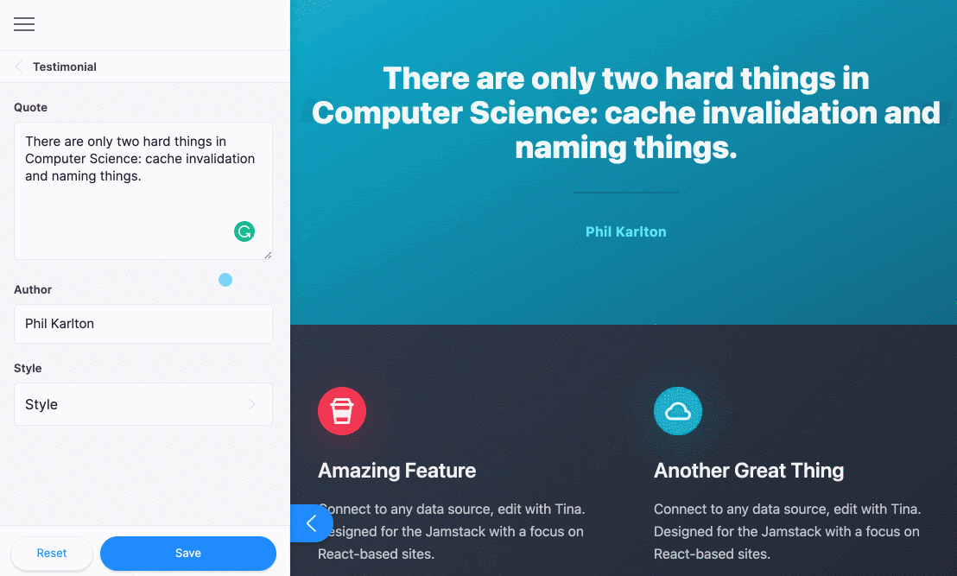
https://tina.io/docs/editing/overview/
See your changes instantly in Tina
Notes:
Tina CMS, just coming out of beta, edits the page block-by-block with results seen instantly in preview.

Slide 33
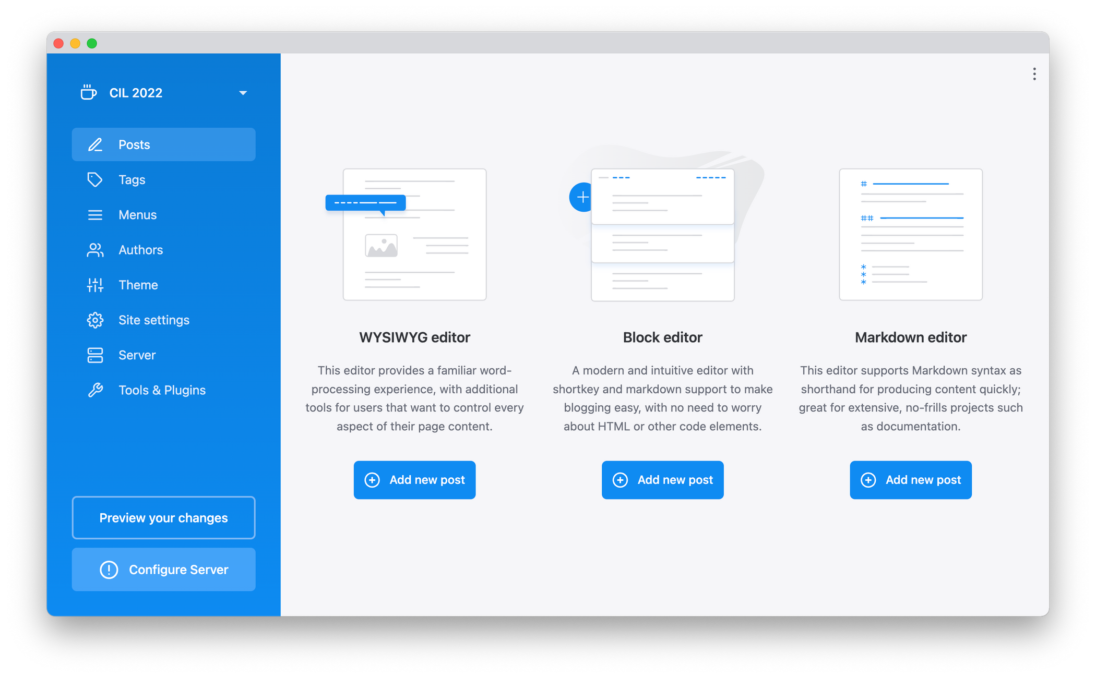
Notes:
Publii, meanwhile, goes offline entirely. The content and site build process is entirely on your computer, like using Microsoft Word to build a website. Only the finished site is uploaded to your server.

Slide 34
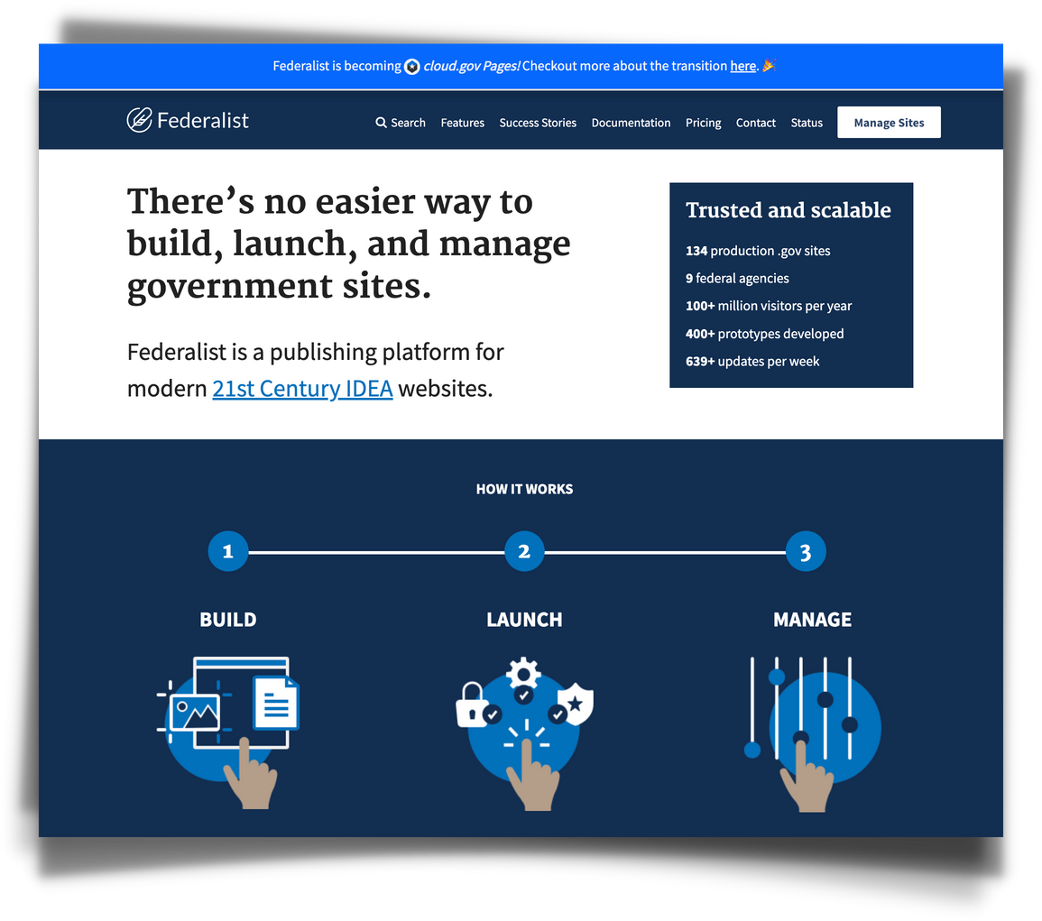
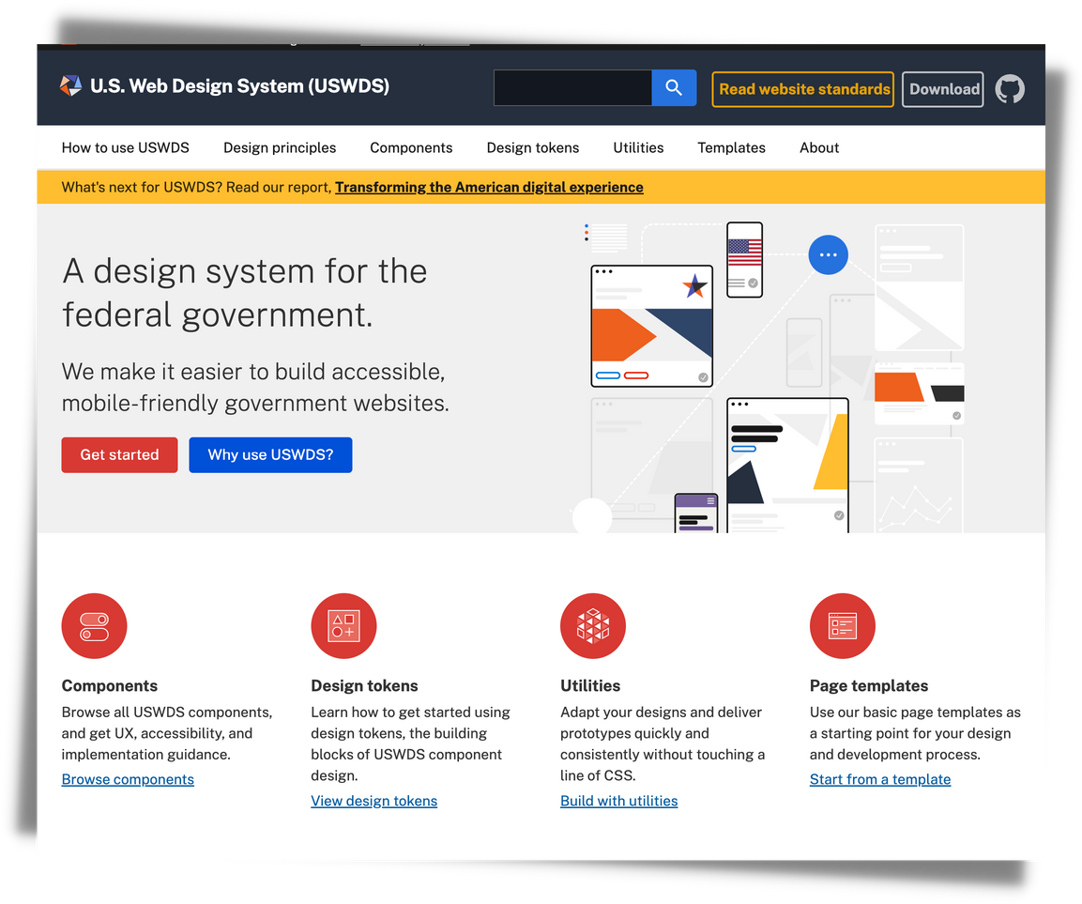
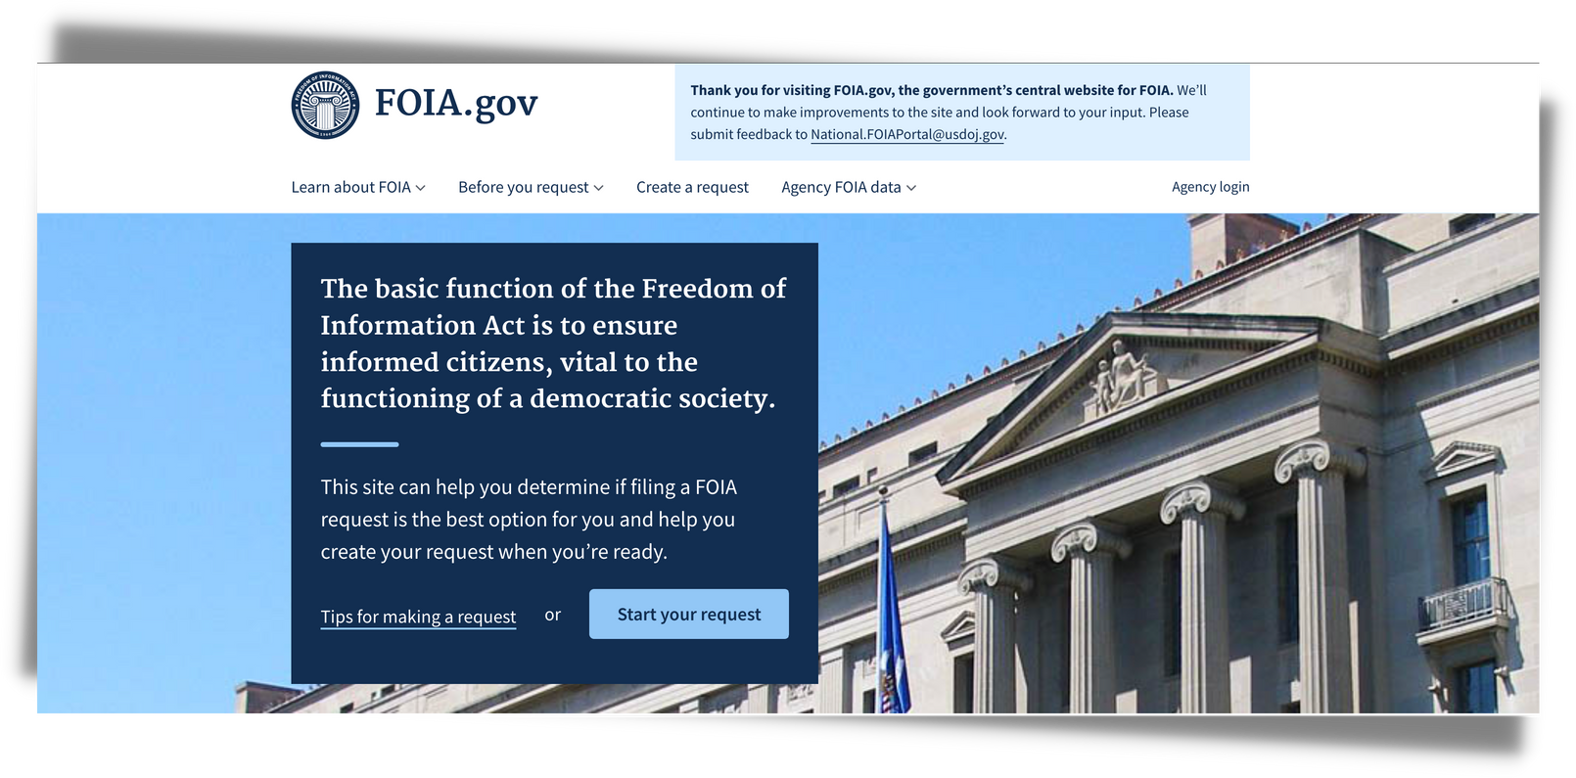
Notes:
Because you're on a server environment with no database, performance is rock solid — both in terms of speed and security.
As a result, it should not be a surprise that governments around the world are among the heaviest users of static site generators.

Slide 35
sunrise from my front yard
Notes:
So where can SSGs shine in the library world?
First some quick tips on venturing into this world.
If you're an experienced web developer with time and support, nearly any site that doesn't require a lot of server-side functionality is possible.
But on your own, find a small, self-contained projects such as your personal portfolio, a blog, or a smaller digital history project to get your feet wet on.

Slide 36
Notes:
There are a many pre-built templates available.
The urge might be to choose one with lots of bells and whistles, but I'd recommend one that's very simple so you can more readily understand the moving parts.
For hosting Github Pages and Netlify are the easiest places to start.
Here are some library-oriented categories of sites that have worked really well with static site generators...

Slide 37
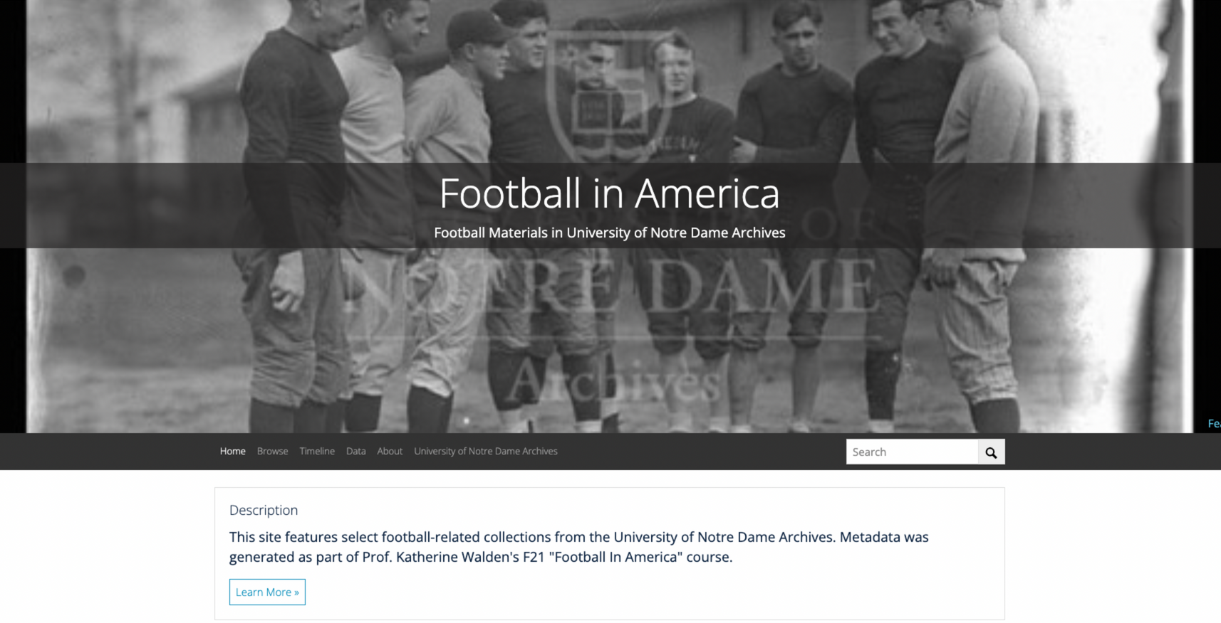
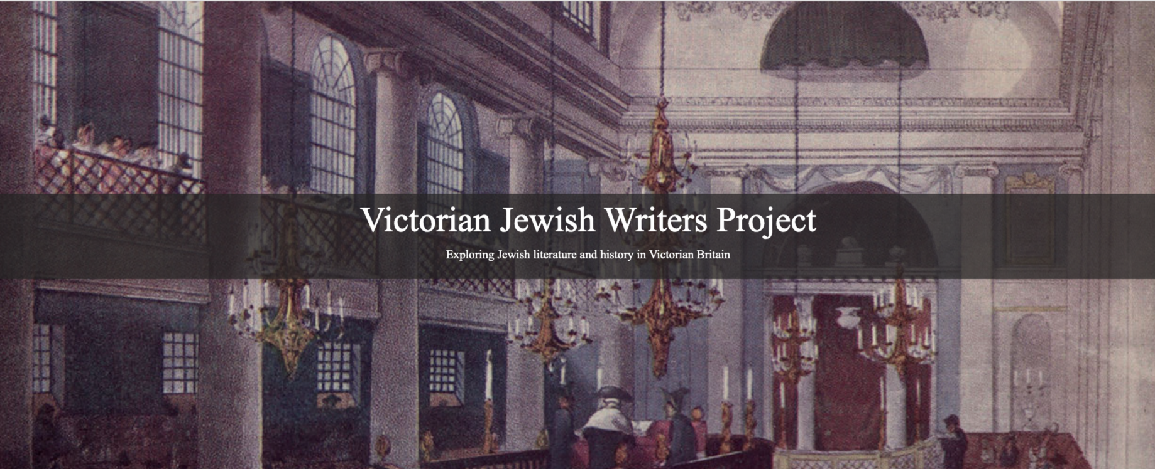
Digital Collections
check out collectionbuilder.github.io
Notes:
I'll start with Digital Collections.
Libraries have been busy building tools for creating digital collections with Jekyll. Check out collection-builder.github.io.
In addition to having full taxonomy and folksonomy tools, they've developed storytelling tools as well. But it's the sheer nature of these sites that will make my archivist friends smile.
Being simply text and images they will be super easy to archive into the future— no digital black hole for these digital projects.

Slide 38
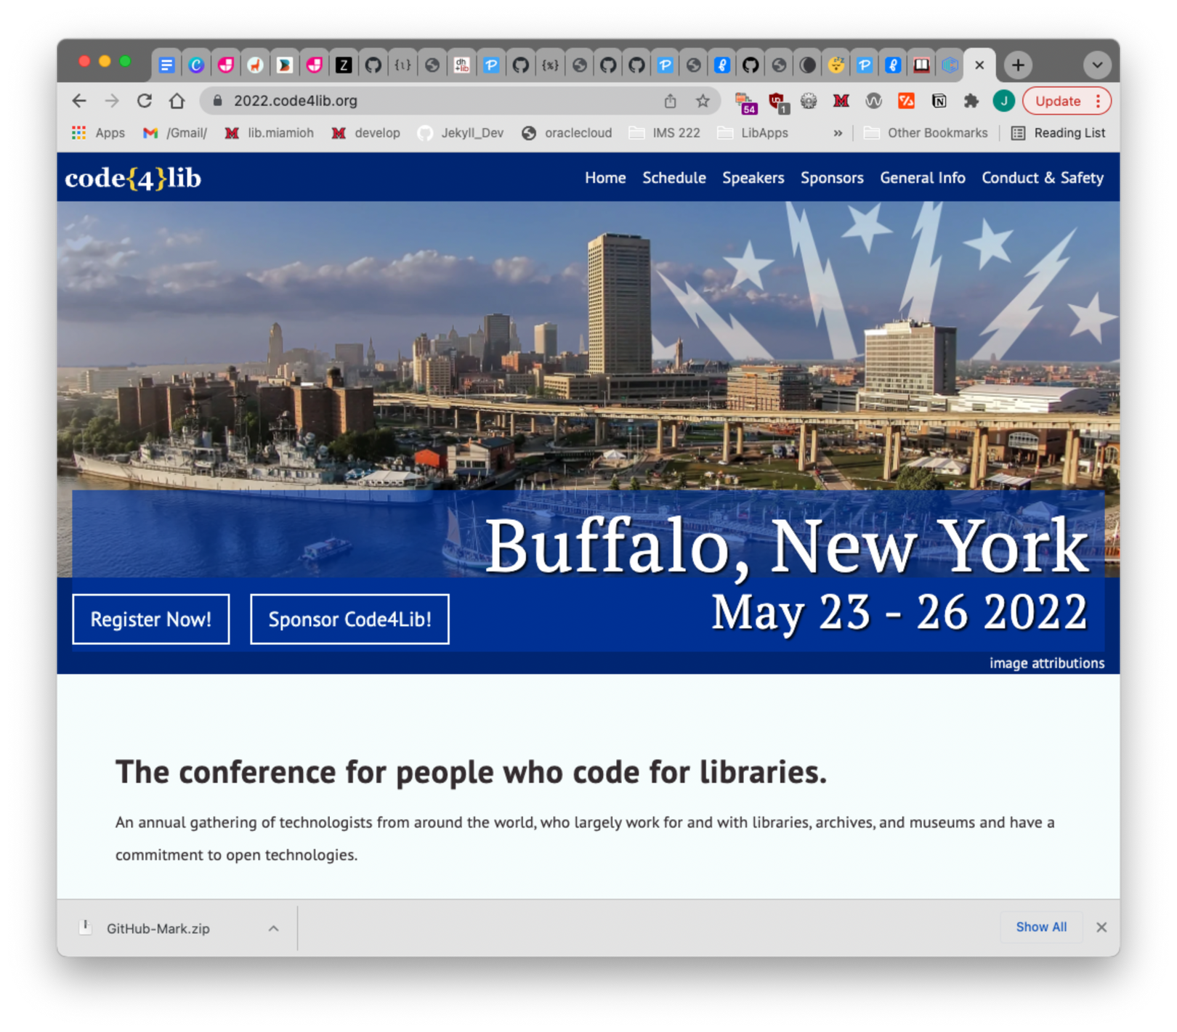
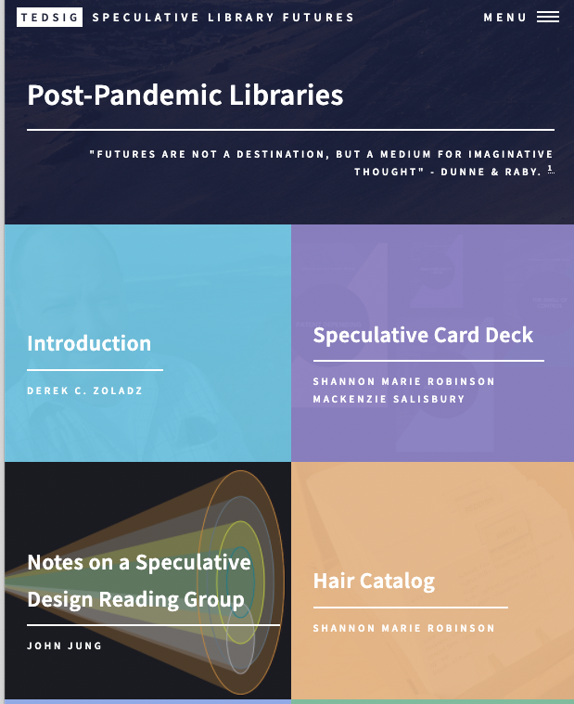
both sites were created on Jekyll
and hosted at Github Pages
Notes:
Conferences, library organizations, and open publishing, meanwhile, are using these tools to be amazing advantages.
The Code4Lib conference website is being edited by library folks from across the country collaborating via GitHub.
The Post-Pandemic Libraries site is an online scholarly project of the Academic Libraries Association of Ohio.
Both projects were built with Jekyll and hosted on Github Pages.

Slide 39
Notes:
Because the resulting sites are small, there are multiple options for free and affordable hosting. Because they bypass ad-driven platforms they make them excellent platform for personal, staff, student, and library sites from blogs to portfolios.
Github Pages is the most popular, but also check out the free offerings at Netlify, Surge, Forge and Vercel.

Slide 40
Notes:
I'll reiterate one point. This method is in its infancy. It's not for every project, but it is truly wonderful.
There are two big categories I don't see static site generators replacing anytime soon.

Slide 41
Notes:
The first category is where you need advanced server-side functionality such as individualized preferences.
It's possible to customize static site content for *categories* of users, based on authentication for example.
But without a database, we can't customize for specific users and hold the settings from session to session.

Slide 42
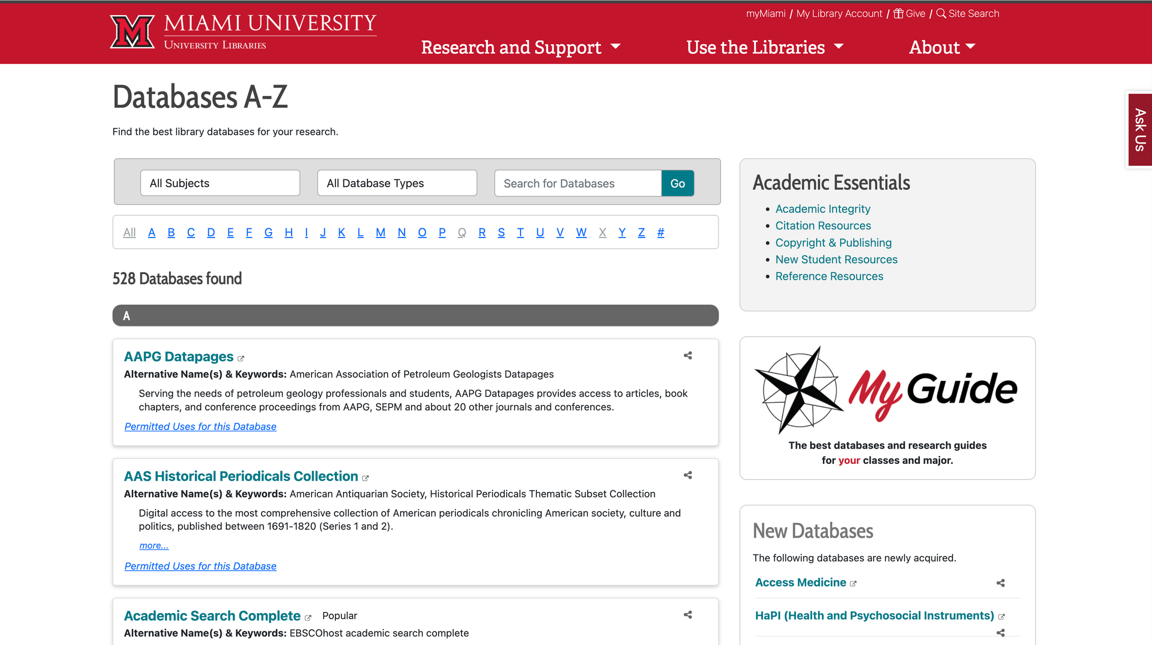
Notes:
The other category is held by
LibGuides. The tight integration of databases, research guides, chat, and reservation tools are popular worldwide for a reason.
Indeed, our website uses LibGuides in addition to Jekyll for core functionality.

Slide 43
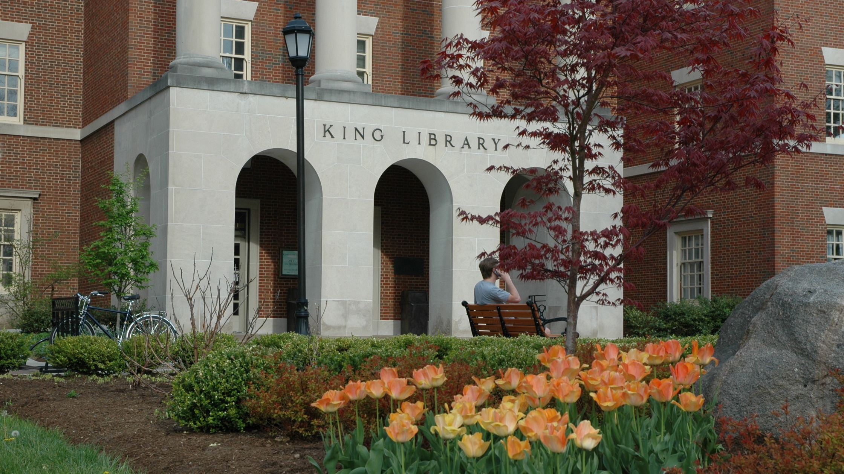
bit.ly/cil22-static-sites
Thank
you!
King Library at Miami University of Ohio
Notes:
Finally, I've created a mini-site of resources— yes, using Jekyll and Github Pages — at bit.ly slash cil22-static-sites
Our world constantly changing and I'm like you, always looking for better ways to serve our communities. As such I truly welcome your contributions and your expertise to the conversation.
Thank you so much!

